Slide 1

Working With Data DATA9910
Week 8
Lucas Rizzo
email: lucas.rizzo@tudublin.ie

Slide 2
Schedule
Week 1 | Set up environment and R notebook
Week 2 | Review Python and practice
Week 3 | Importing data with R
Week 4 | Interpreting Data (summary statistics, data visualisation)
Week 5 | Data manipulation in R. Numpy and Pandas introduction in Python.
Week 6 | Review week (work on assignment)
Week 7 | Data visualisation in Python
Week 8 | Data processing (regular expressions)
Week 9 | Intro to databases (SQL) Assignment 1 deadline
Week 10 | Loading and extracting data (SQL)
Week 11 | Analytical SQL functions
Week 12 | Procedural SQL
Week 13 | Working on Assignment Assignment 2 deadline

Slide 3
Overview
Regular expressions
Identifying patterns in text
Capturing groups
Examples in Python and R

Slide 4
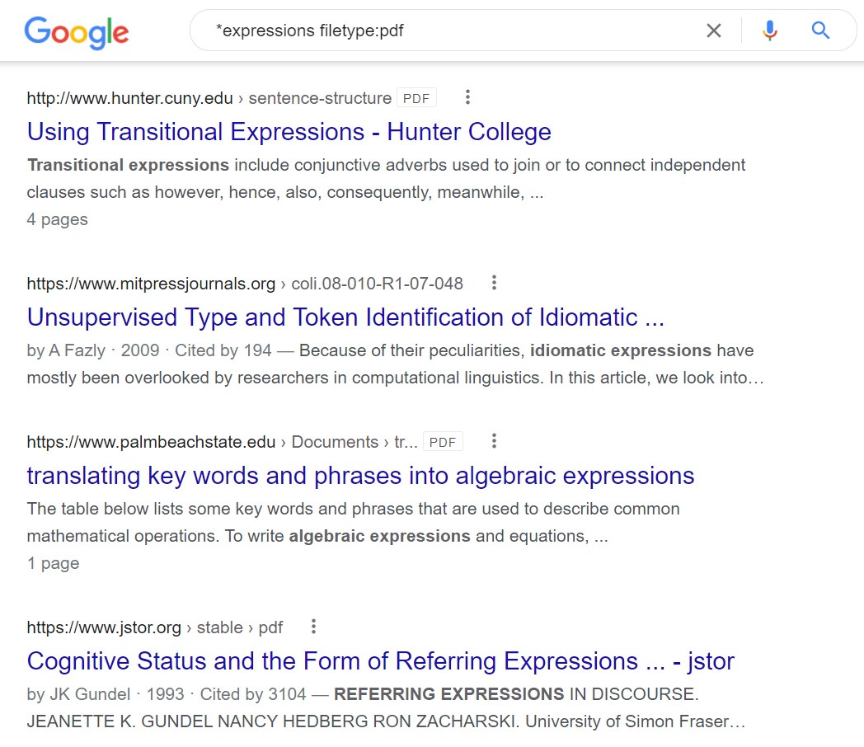
Regular Expressions
Regular Expressions are tools for advanced pattern matching in text
Useful for:
File searches
Find and replace in text
Extracting data from free-text sources

Slide 5
When to Use Regular Expressions?
Extracting data from text-based sources
Text must follow regular patterns
RegEx is about identifying and exploiting patterns in the text

Slide 6
Task 1 – Identifying Patterns
Go to https://www.businessinsider.com/the-20-best-paid-ceos-of-the-ftse-100-2017-8?r=US&IR=T
What information can we extract from this list?
In words, identify the pattern that each entry follows
Answer in the next slide...

Slide 7

Task 1 - Answer
20 highest-paid FTSE 100 CEOs and their salaries
Each entry follows a pattern like that:
Number
Dot (.)
Name
Comma (,)
Company
Dash (-)
Value in million pounds

Slide 8
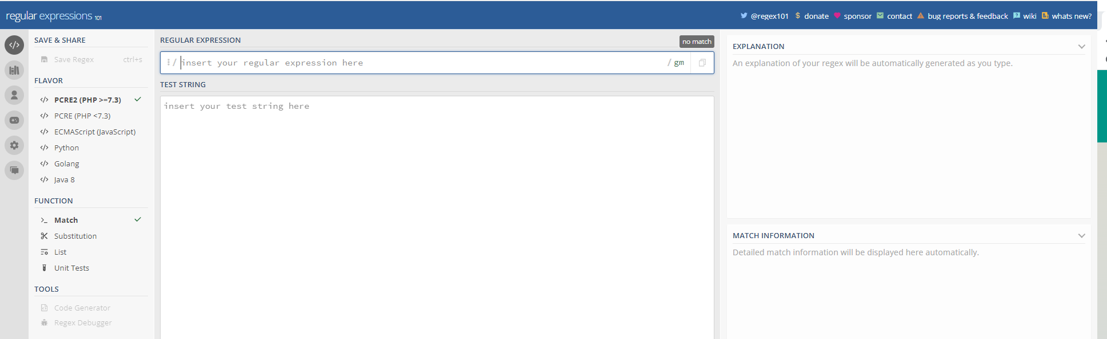
Testing Regular Expressions
Regular expressions can be fiddly
Having an easy place to test it will help us develop our own
It's always good to test out your regular expressions
https://regex101.com is a free online tool to allow you to do this

Slide 9
Matching Individual Characters
It's simple to match individual characters
Regex allows us to search for a substring simply by inputting it directly
This is similar to the basic find/replace functionality in a text-editor

Slide 10
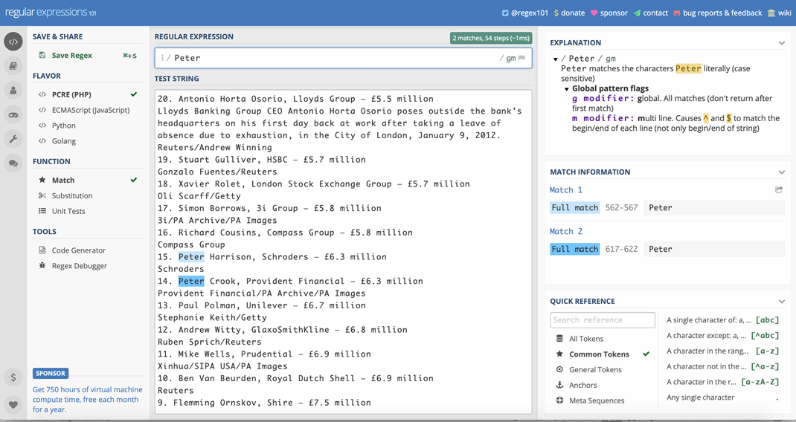

Slide 11
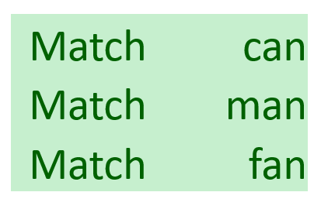
Question
How can we write a regex that will match each of the following words?

Slide 12
Question
How can we write a regex that will match each of the following words?
Some letter followed by an

Slide 13
The Dot Character
Within a regular expression the character . (dot) means "match any single character"

Slide 14
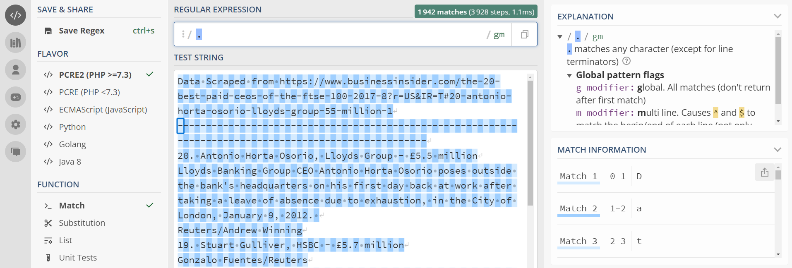
The Dot Character
Within a regular expression the character . (dot) means "match any single character"

Slide 15
The Dot Character
If . means "match anything" how do we match an actual full stop?

Slide 16
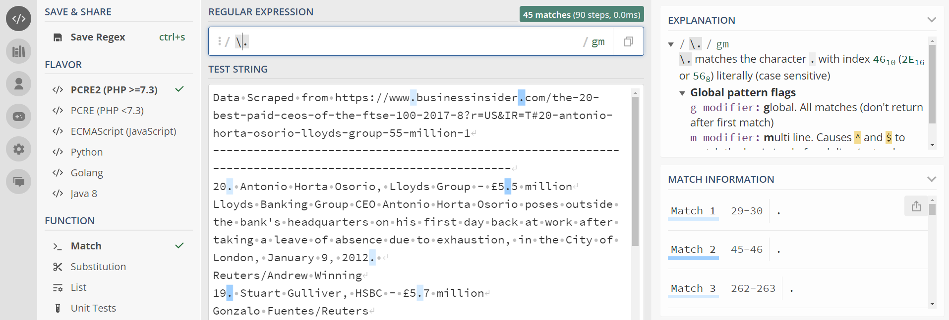
The Dot Character
If . means "match anything" how do we match an actual full stop?
\.

Slide 17
Task 2 - Using the dot
How can we write a regex that will match each of the following words?
Answer in the next slide...

Slide 18
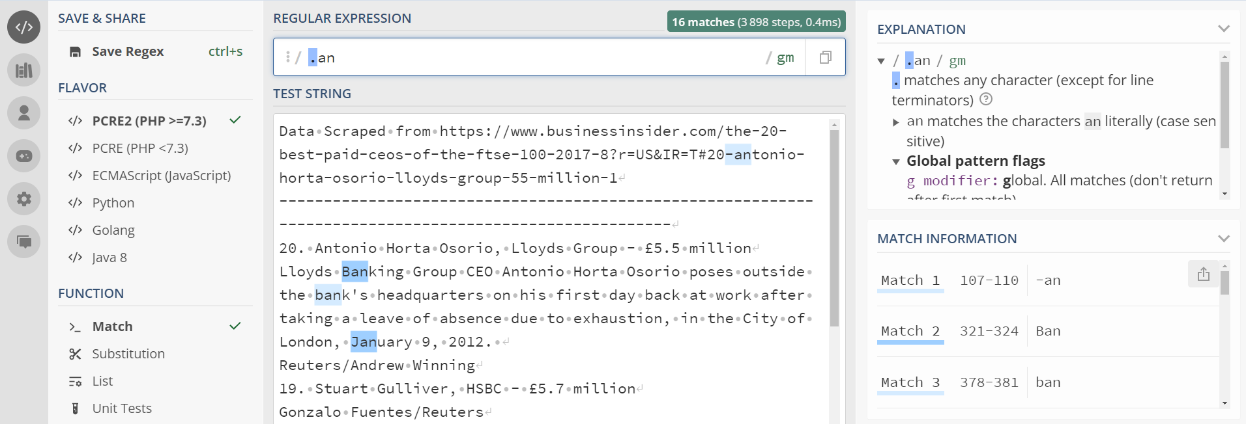
Task 2 - Answer

Slide 19
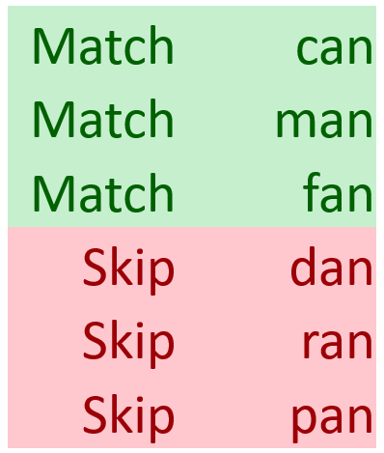
Question
How do we match only the words in green?

Slide 20
Question
How do we match only the words in green?
Only c, m and f followed by an

Slide 21
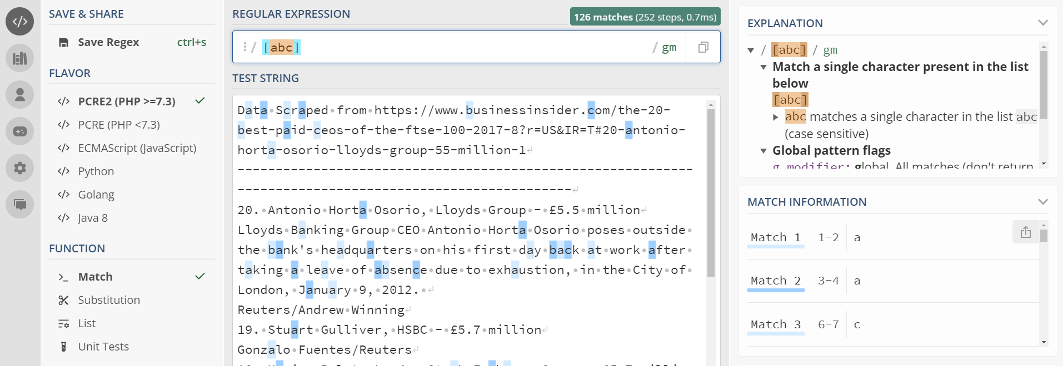
Matching Specific Characters
If we want to allow multiple options for a match we can specify them inside square brackets
The expression [abc] will match a single a, b or c character

Slide 22
Task 3 - Matching Specific Characters
How can we write a regex that will match only the words in green?
Answer in the next slide...

Slide 23
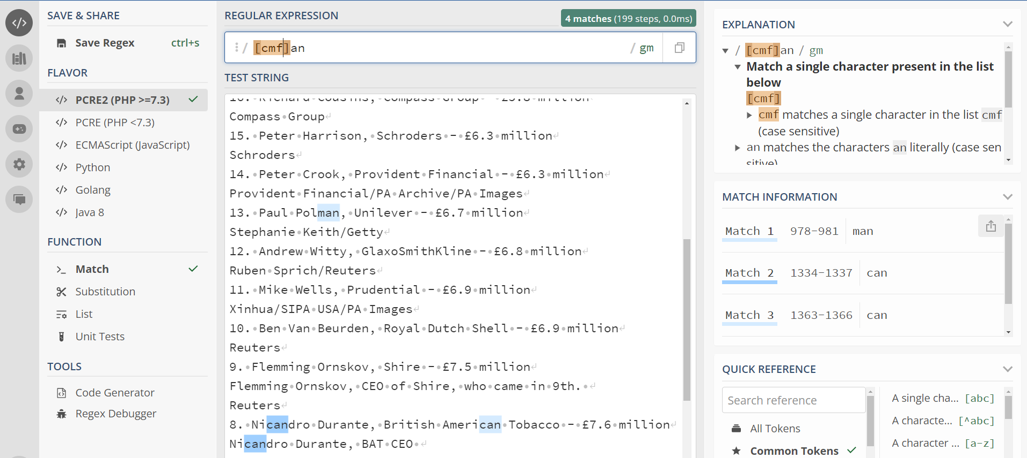
Task 3 - Answer

Slide 24
Negative Patterns
Sometimes it's more useful to specify what we don't want to match rather than what we do
Regular expressions allow us to do this using a negative matching syntax
Negative matching uses square brackets and starts with the hat ^ character.
[^abc] will match any single character except for a, b or c

Slide 25
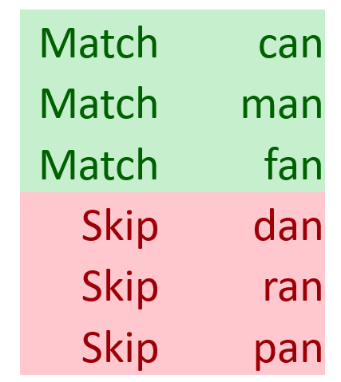
Question
Using negative matching, how do we match only the words in green?

Slide 26
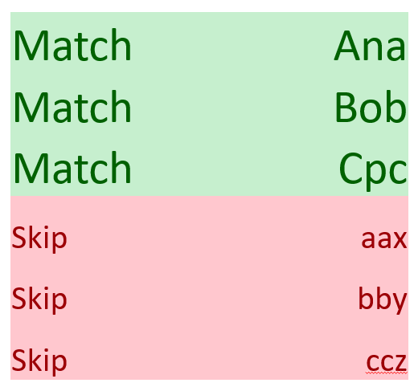
Question
How do we match any word beginning with a capital letter?

Slide 27
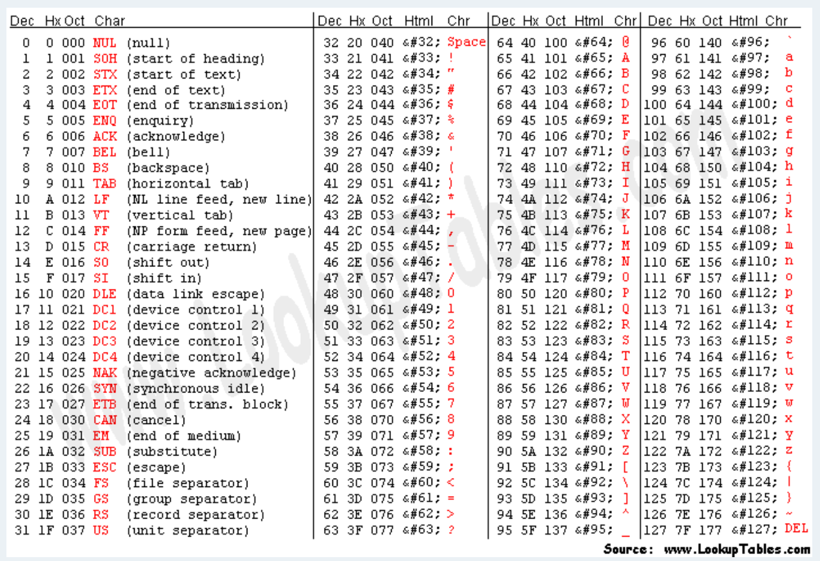
Character Ranges
Every character in a string is represented using an ASCII code
Capital A has a code of 65, capital B has a code of 66 etc.
Lower-case a has a code of 97, lower z has a code of 122
The full range of codes can be found online http://www.asciitable.com

Slide 28
Character Ranges
Because each character has an underlying numeric code, we can use ranges to specify characters inside square brackets
[A-Z] will match any character with a code between 65 (A) and 90 (Z)
[a-z] will match any character with a code between 97 (a) and 122 (z)
[A-Za-z0-9] will match any uppercase or lowercase letter or number
The - symbol is a special character when used inside square brackets
If we want to match a - character, it needs to be the first symbol inside the brackets
[-A-Za-z] matches any letter or a - character

Slide 29
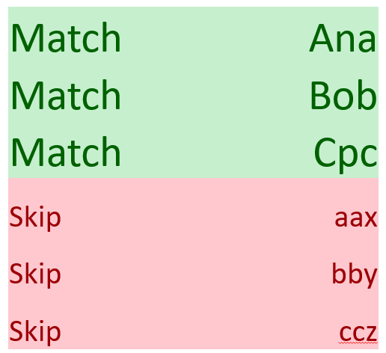
Task 4 - Character Ranges
How can we write a regex that will match only the words in green?
Answer in the next slide...

Slide 30
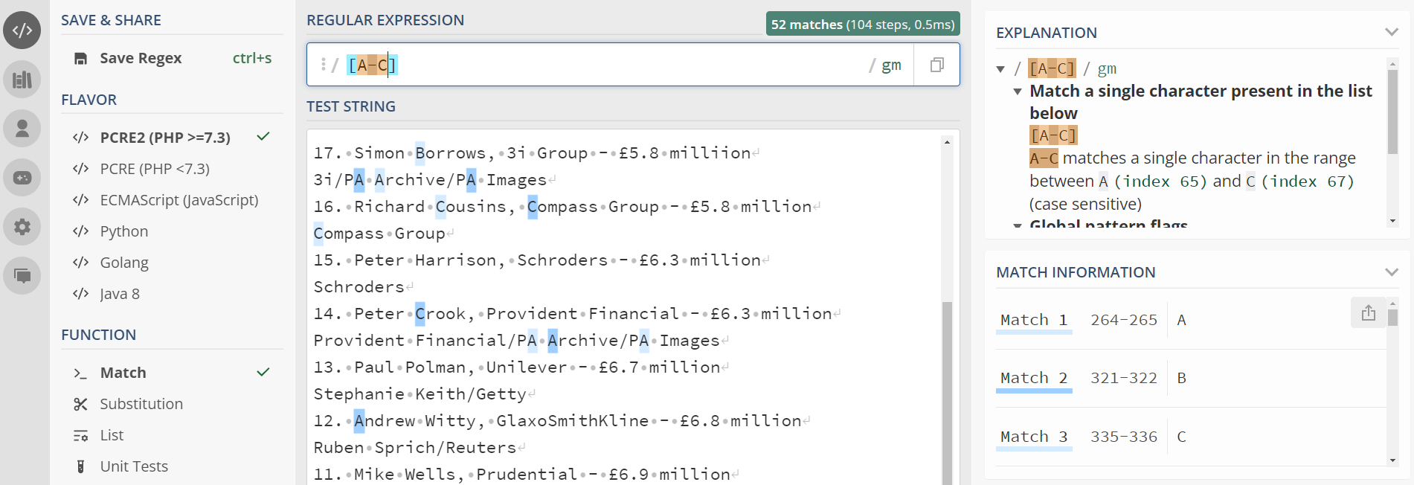
Task 4 - Character Ranges

Slide 31
Metacharacters
We've seen how we can use character ranges to match different types of characters
These involve a lot of keystrokes, so RegEx allow us to use metacharacters (or shortcuts) for different types of ranges
\d matches any numeric digit
\D matches any non-digit character
\s matches any whitespace character
\S matches any non-whitespace character
\w matches any alphanumeric character

Slide 32
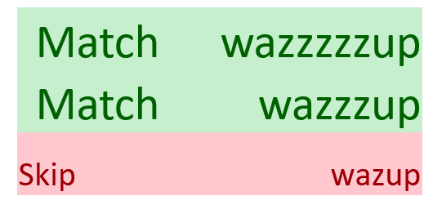
Question
How do we match any word with more than one character?

Slide 33
Repetition
Say we wanted to match 3 digits, we could do this using \d\d\d
However, RegEx gives us an easier way to do this, using curly brace notation
[<match>]{<repetitions>}
[<match>]{<min repetitions>, <max repetitions>}
We can use this to match 3 z's using z{3} or between 2 and 5 digits [\d]{2,5}

Slide 34
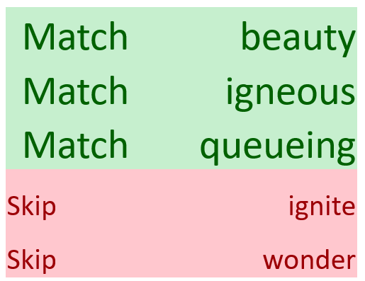
Task 5 - Repetition
Write a regular expression which will match between 3 and 5 consecutive vowels (not the whole word, just the vowel cluster)
Answer in the next slide...

Slide 35
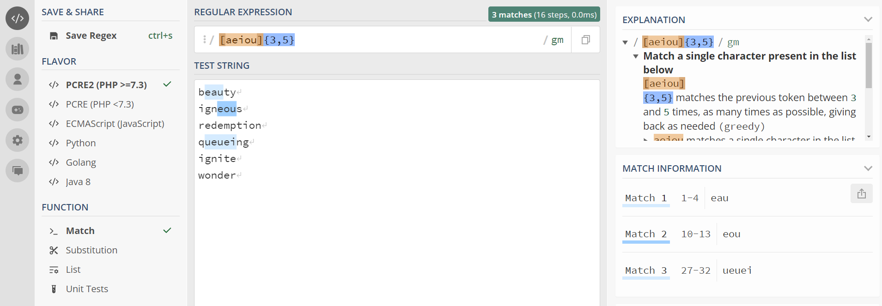
Task 5 - Answer

Slide 36
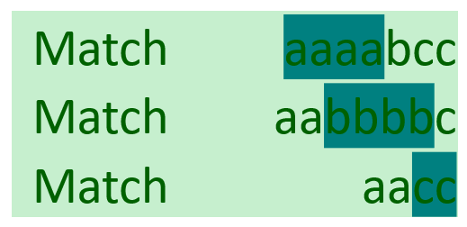
Kleene Star and Kleene Plus
Named after Stephen Kole Kleene (the inventor of Regex)
A * after a character matches zero or more of that character
A + after a character matches one or more of that character
[a]+
[b]+
[c]+

Slide 37
Task 6 - Repetition
Write a regular expression which will match any word containing between 3 and 5 consecutive vowels (the whole word)
Answer in the next slide...

Slide 38
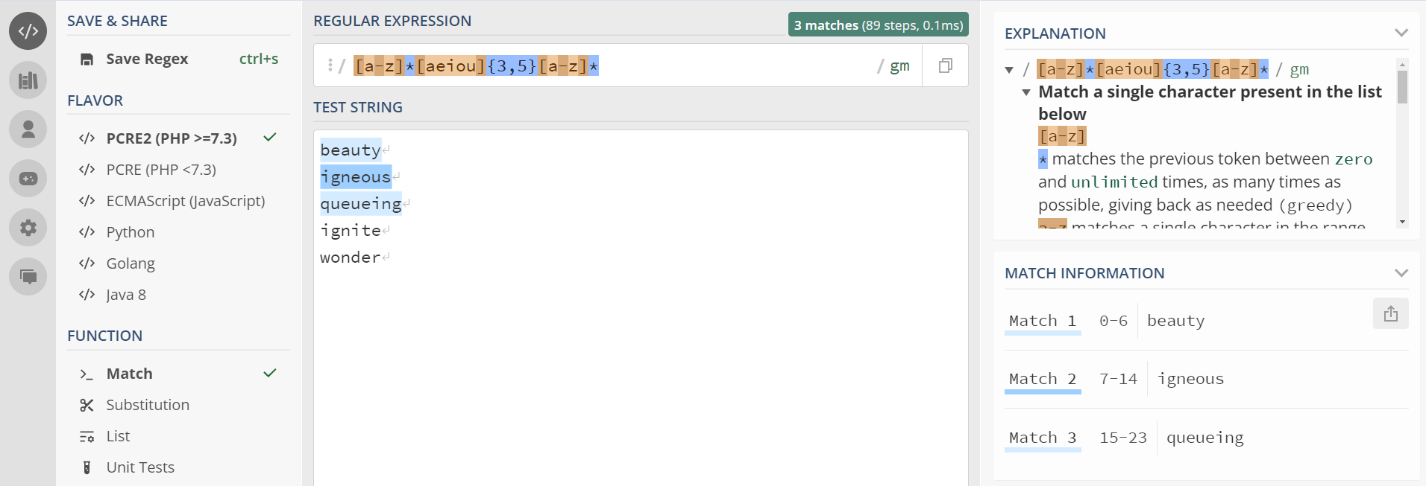
Task 6 - Answer

Slide 39
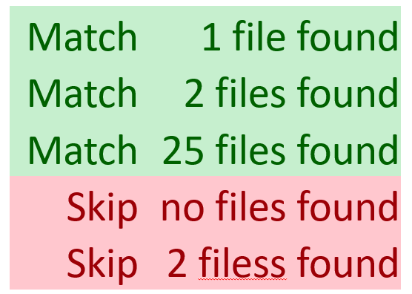
Optionality
The ? operator matches zero or one of the preceding character
Similar to the * character but doesn't allow repetition
Can also be used with square brackets
[\d]+ files? found
Note the spaces

Slide 40
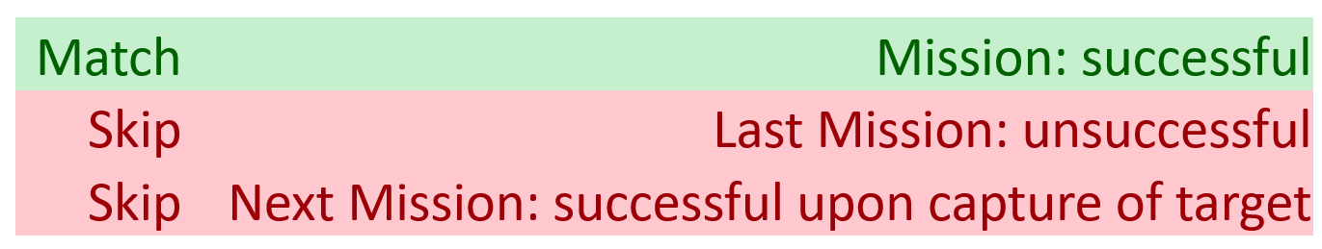
Line Boundaries
Sometimes it's useful to match the beginning and ending of a line
The ^ character (when not in square brackets) denotes the start of a line
The $ character denotes the end of a line
^Mission:.*successful$

Slide 41
Capturing Groups
So far we've only talked about matching strings
Often we want to do something with the text we matched
For example, we may want to extract the image dimensions and extensions from the filenames in the example below
hasselhoff_1640x890.png
lolcat_1720x580.jpg
[^_]*_(\d+)x(\d+)\.([a-zA-Z]{3})

Slide 42
Capturing Groups
So far we've only talked about matching strings
Often we want to do something with the text we matched
For example, we may want to extract the image dimensions and extensions from the filenames in the example below
hasselhoff_1640x890.png
lolcat_1720x580.jpg
[^_]*_(\d+)x(\d+)\.([a-zA-Z]{3})
Anything except _ repeated 0 or more times

Slide 43
Capturing Groups
So far we've only talked about matching strings
Often we want to do something with the text we matched
For example, we may want to extract the image dimensions and extensions from the filenames in the example below
hasselhoff_1640x890.png
lolcat_1720x580.jpg
[^_]*_(\d+)x(\d+)\.([a-zA-Z]{3})
A dash _

Slide 44
Capturing Groups
So far we've only talked about matching strings
Often we want to do something with the text we matched
For example, we may want to extract the image dimensions and extensions from the filenames in the example below
hasselhoff_1640x890.png
lolcat_1720x580.jpg
[^_]*_(\d+)x(\d+)\.([a-zA-Z]{3})
Our first group, indicating the width of the image

Slide 45
Capturing Groups
So far we've only talked about matching strings
Often we want to do something with the text we matched
For example, we may want to extract the image dimensions and extensions from the filenames in the example below
hasselhoff_1640x890.png
lolcat_1720x580.jpg
[^_]*_(\d+)x(\d+)\.([a-zA-Z]{3})
An x

Slide 46
Capturing Groups
So far we've only talked about matching strings
Often we want to do something with the text we matched
For example, we may want to extract the image dimensions and extensions from the filenames in the example below
hasselhoff_1640x890.png
lolcat_1720x580.jpg
[^_]*_(\d+)x(\d+)\.([a-zA-Z]{3})
Our second group, indicating the length of the image

Slide 47
Capturing Groups
So far we've only talked about matching strings
Often we want to do something with the text we matched
For example, we may want to extract the image dimensions and extensions from the filenames in the example below
hasselhoff_1640x890.png
lolcat_1720x580.jpg
[^_]*_(\d+)x(\d+)\.([a-zA-Z]{3})
A dot . (dots need to be escaped)

Slide 48
Capturing Groups
So far we've only talked about matching strings
Often we want to do something with the text we matched
For example, we may want to extract the image dimensions and extensions from the filenames in the example below
hasselhoff_1640x890.png
lolcat_1720x580.jpg
[^_]*_(\d+)x(\d+)\.([a-zA-Z]{3})
The third group. Three letters, upper or lower case.

Slide 49
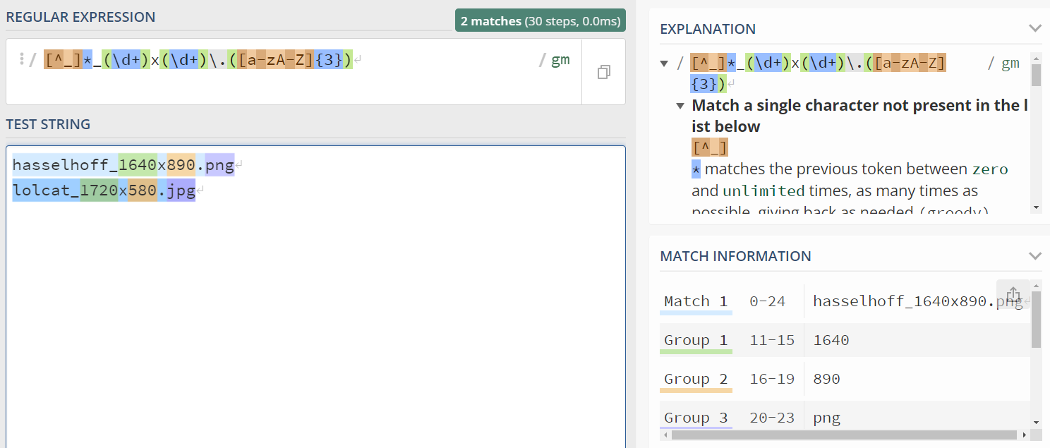
Capturing Groups
More on how to use groups in the next slides

Slide 50
RegEx in Python
Regular expressions are available through Python's re module
First we build our pattern up as a string
pattern = "(\d+) \w \w [aeiou]$"
Then we create a regular expression from the pattern using re.compile
regex = re.compile(pattern)

Slide 51
Using Python Regexes
Once we have our regular expression object we can use it to search text.
Python gives us 3 methods to search text using a regex
re.match()
re.search()
re.findall()

Slide 52
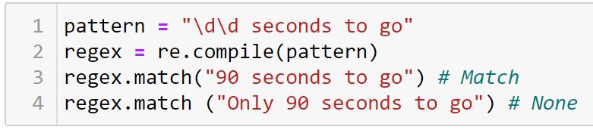
The match() function
The match() function will check if the regex matches the text but will only look at the beginning of the string

Slide 53
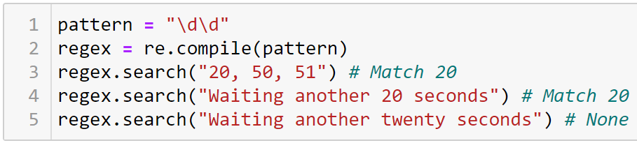
The search() function
The search() function will search right through the string, returning the first match it finds (None otherwise)

Slide 54
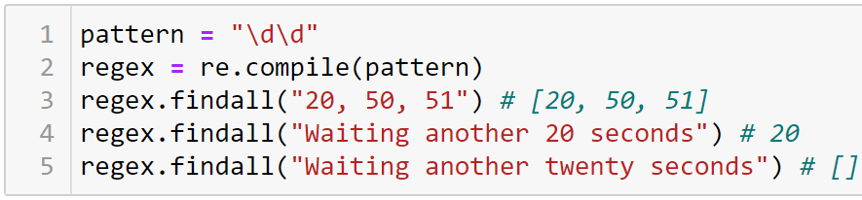
The findall() function
findall() is similar to search() but it will return every match within the string

Slide 55
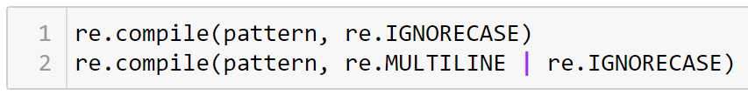
Compilation Flags
We can control the behaviour of the Regex when we compile it using flags
https://docs.python.org/3/howto/regex.html#compilation-flags
The IGNORECASE flag matches both upper and lower case letters
The MULTILINE flag enables the ^ and $ symbols

Slide 56
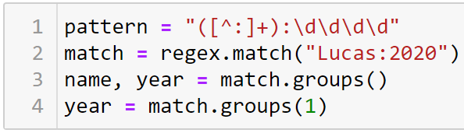
The groups() function
When we get a match object back we can check for our capturing groups using the groups() function
Matches are returned as a tuple so we can assign to multiple variables
We can also return a group by index

Slide 57
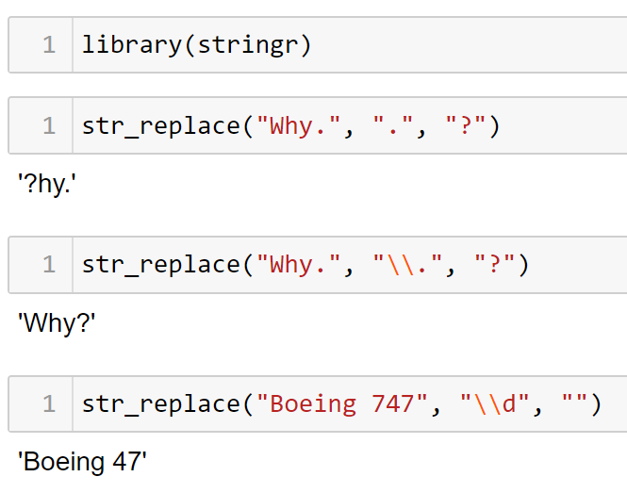
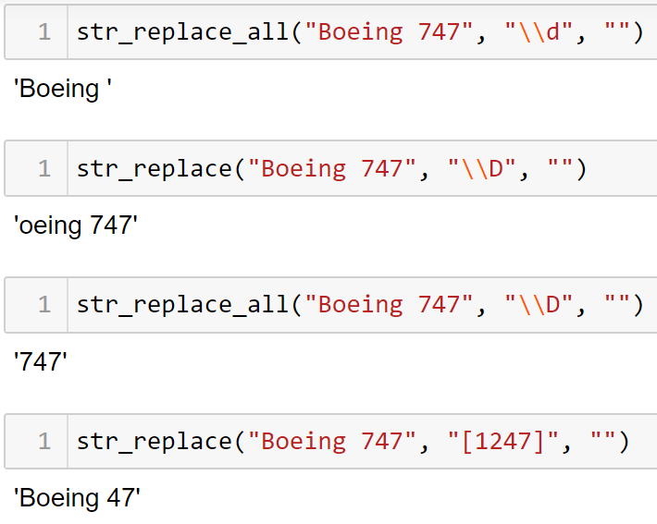
RegEx in R
Also in R we can use certain functions to replace patterns in a string or to extract them.
The package stringr offers some functions

Slide 58
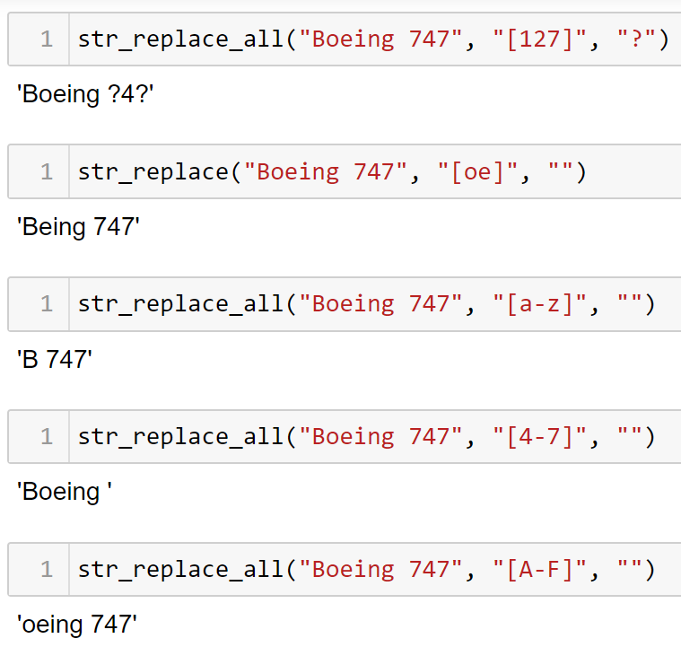
RegEx in R

Slide 59
RegEx in R
R offers a number of pre-built classes that you can use inside []:
[:punct:]: punctuation.
[:alpha:]: letters.
[:lower:]: lowercase letters.
[:upper:]: upper class letters.
[:digit:]: digits.
[:xdigit:]: hex digits.
[:alnum:]: letters and numbers.
[:cntrl:]: control characters.
[:graph:]: letters, numbers, and punctuation.
[:print:]: letters, numbers, punctuation, and whitespace.
[:space:]: space characters (basically equivalent to \s).
[:blank:]: space and tab.

Slide 60
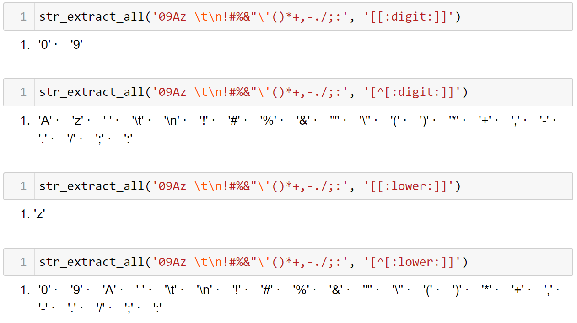
RegEx in R

Slide 61
Summary
Regular expressions and when to use them
Identifying patterns
Capturing groups
Examples in Python and R

Slide 62
Lab
Step-by-step walkthrough in your Jupyter Notebook

Slide 63
Questions?

